Slide 1

MACHINE ELEMENTS 2 | FINAL PRESENTATION
WOODCHIPPER
DESIGN
A comprehensive design analysis focusing on structural integrity, power transmission, and ISO standard component selection.

Slide 2

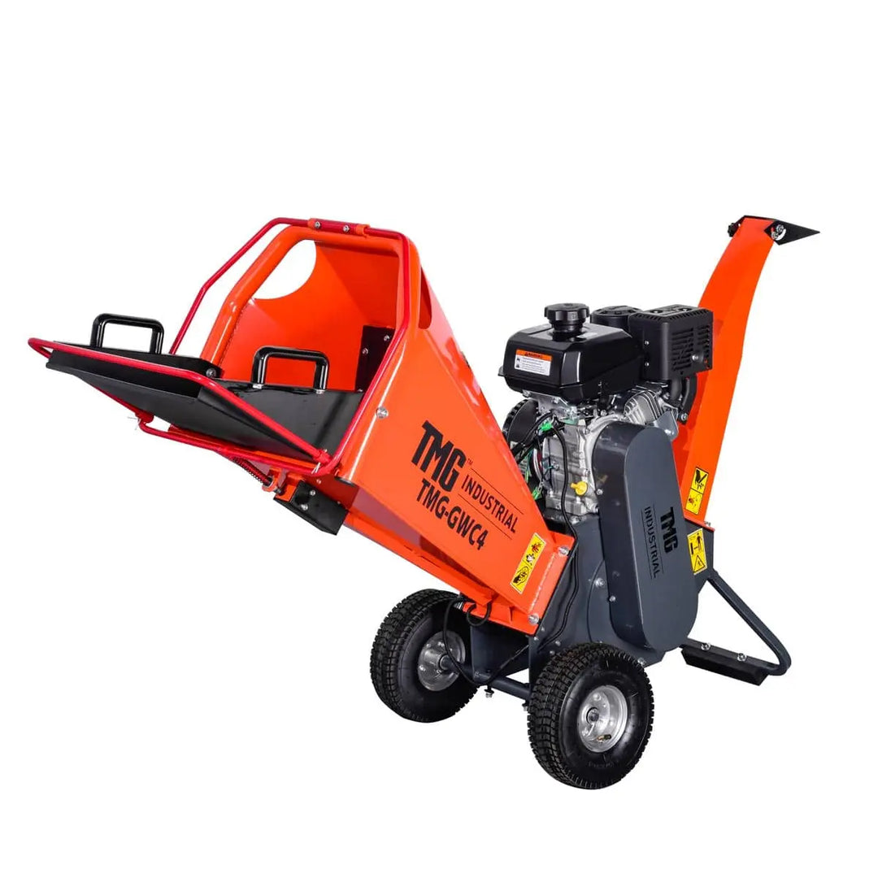
AGENDA & OBJECTIVES
PROJECT SCOPE
Engineer a robust, mobile woodchipper driven by a 7.5 kW electric motor to process 50mm branch diameter.
PRESENTATION STRUCTURE
➤
Part I: Material Selection & Core Assembly
➤
Part II: Power Unit Specification
➤
Part III: Standard Machine Elements
➤
Part IV: Engineering Calculations
➤
Part V: System Integration

Slide 3

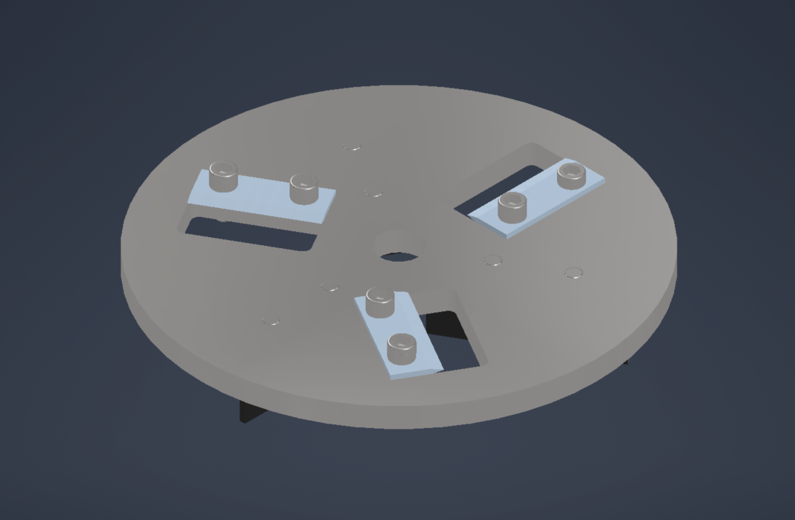
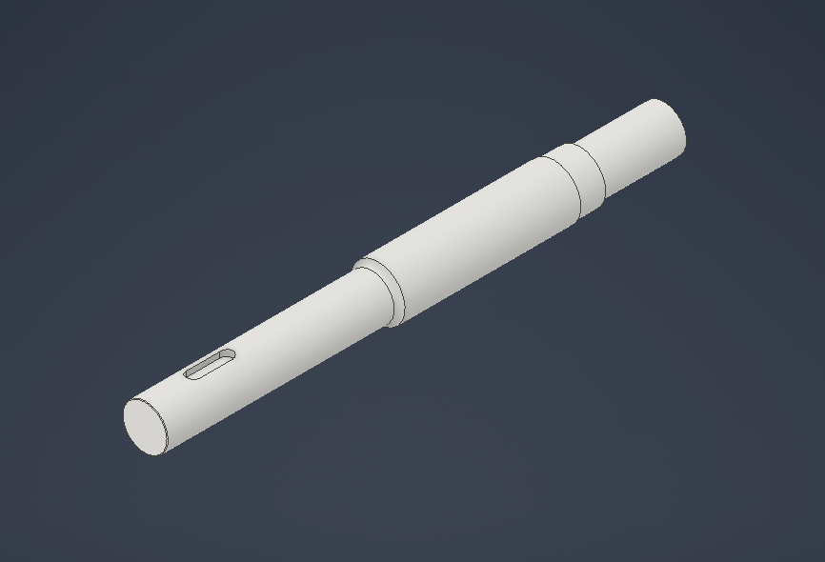

CORE ASSEMBLIES
Design specifications based on high-inertia loads.
CUTTER ASSEMBLY
Disc: Ø400 mm | AISI 4140. Selected for flywheel effect (Inertia).
Main Shaft: Ø35 mm | C45 Steel. Standard carbon steel for machinability.
Knives: D2 Tool Steel. 58-60 HRC for edge retention.

Slide 4
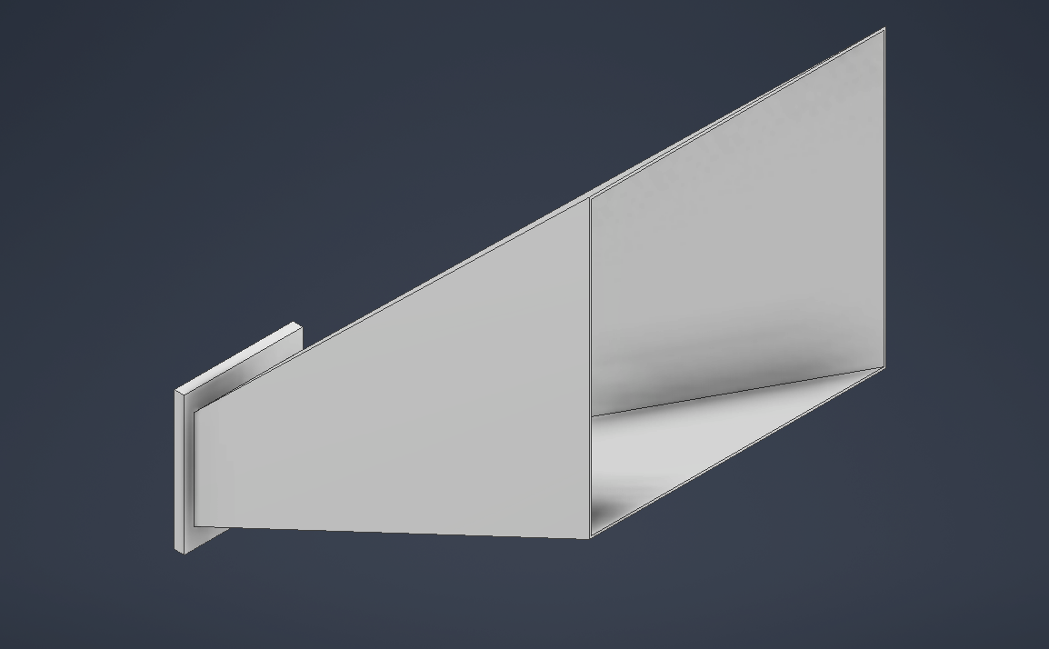
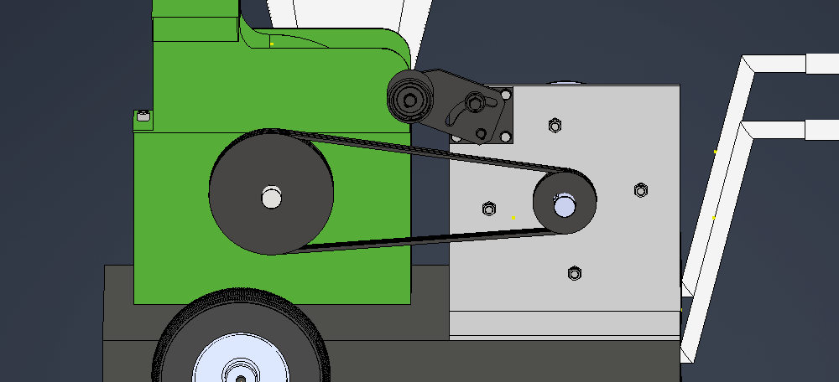
STRUCTURAL FRAME
Feeder: Alu 6061-T6. Lightweight intake.
Chassis: ASTM A36. Weldable structural steel.

Slide 5
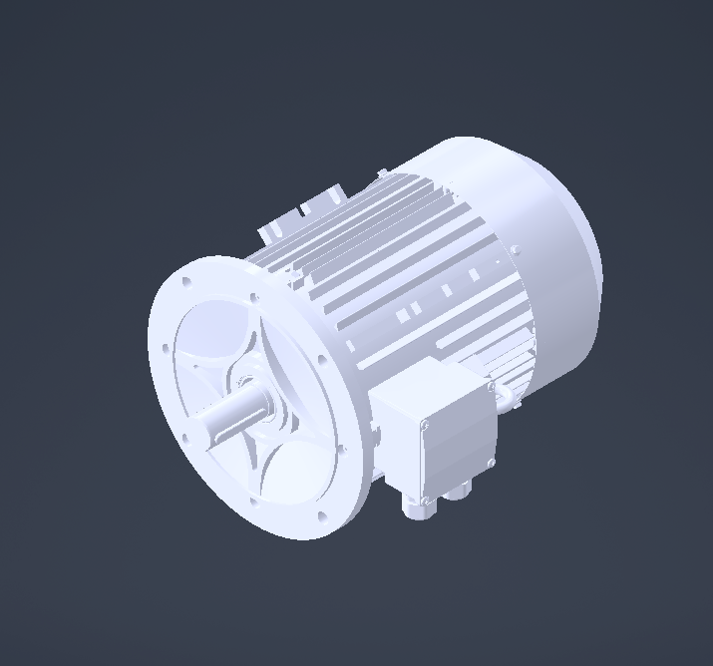
POWER UNIT SPECIFICATION
SEVA-TEC MX3-132S2-2
This high-efficiency IE3 motor serves as the primary driver.
Parameter | Specification
Rated Power | 7.50 kW
Speed | 2920 RPM
Weight | 53.8 kg
Mounting | IM B5 (Flange)

Slide 6

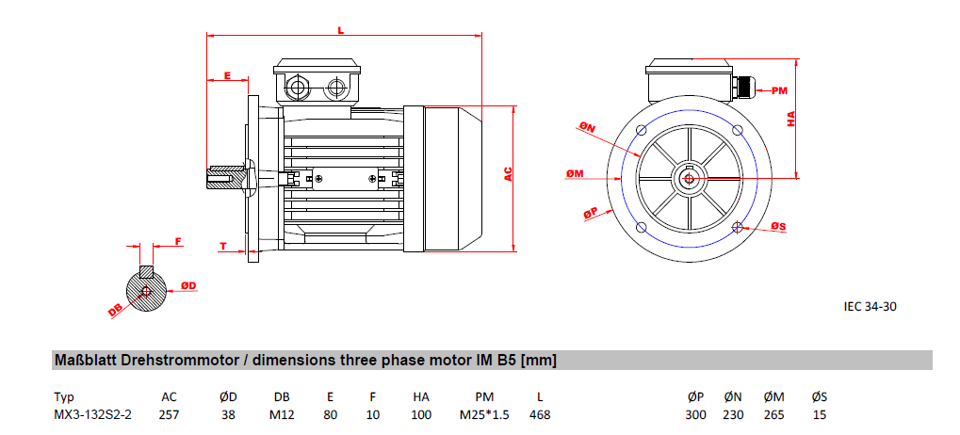
INTERFACE DIMENSIONS
DESIGN CONSTRAINTS
Manufacturer datasheets imposed specific geometric constraints on the drivetrain.
➤
Shaft Diameter: 38 mm
Dictated the use of a 38mm Taper Lock Bushing.
➤
Mounting Holes: 15 mm
Selection of M15 fasteners (Fine Pitch).

Slide 7
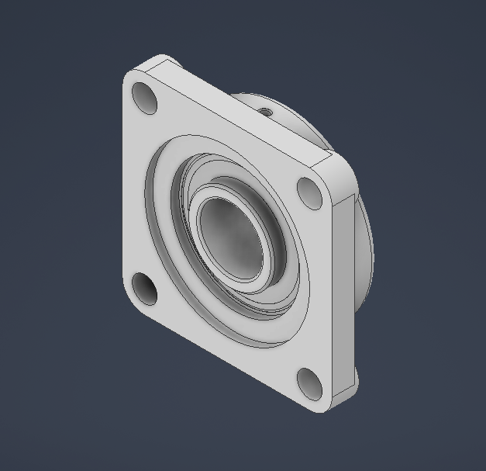
ROTOR SUPPORT
UCF 207 FLANGE UNIT
Standard ISO 4-bolt flange units were selected to support the Ø35mm main shaft.
Spec | Value
Standard | ISO 3228
Bore | 35 mm
Housing | Cast Iron (HT200)
Feature | Self-Aligning Insert

Slide 8
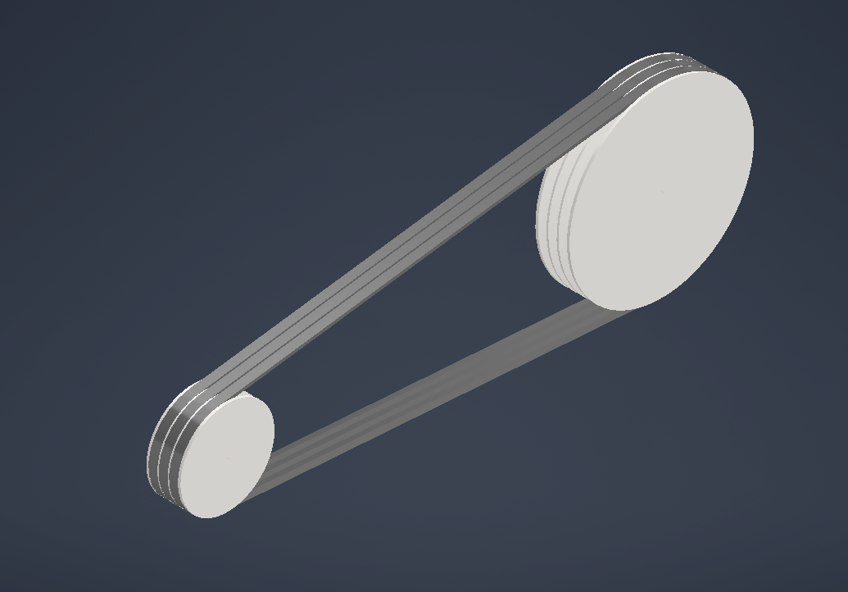
POWER TRANSMISSION
V-BELT DRIVE (ISO 4184)
A multi-belt drive system designed for shock absorption and torque transfer.
➤
Belt Profile: SPZ Section (Metric Wedge)
➤
Configuration: 3 Parallel Belts
➤
Pulleys: ISO 4183 Deep Groove
➤
Tensioner: Manual Slotted Bracket

Slide 9
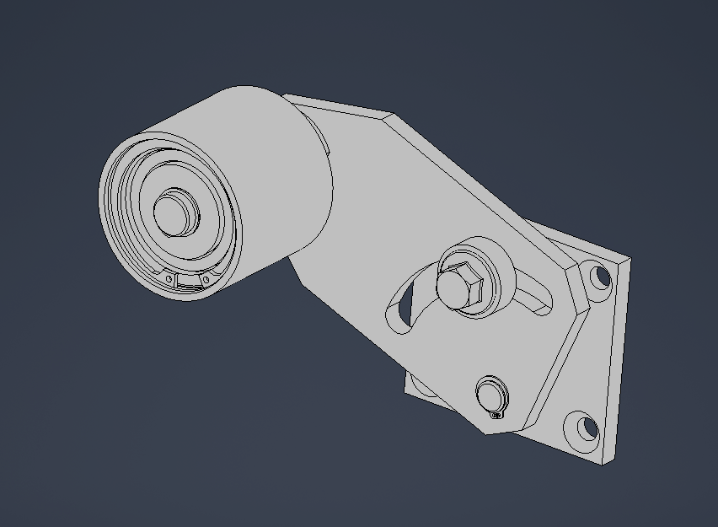
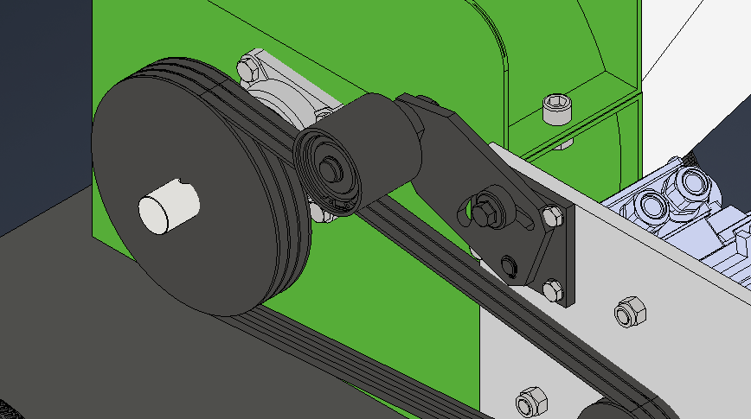
TENSIONER
Manually Adjustable Pivoting Idler Tensioner
Consisting of tensioner arm, tensioner pulley and a pivot bolt.

Slide 10
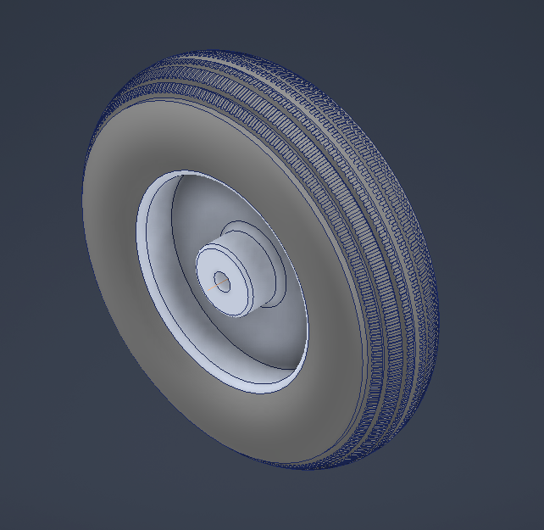
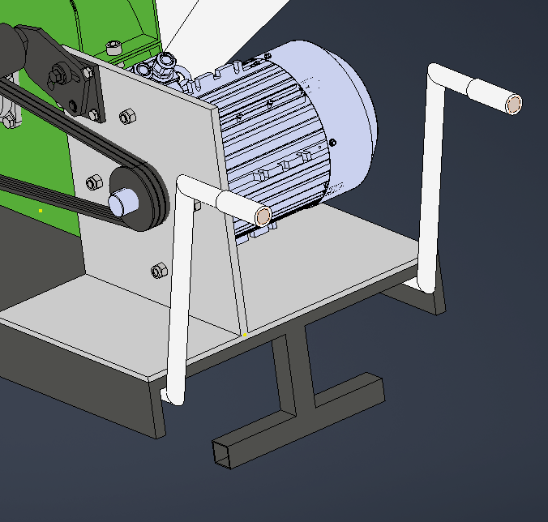
MOBILITY
300mm pair of wheels and handle bars were used

Slide 11
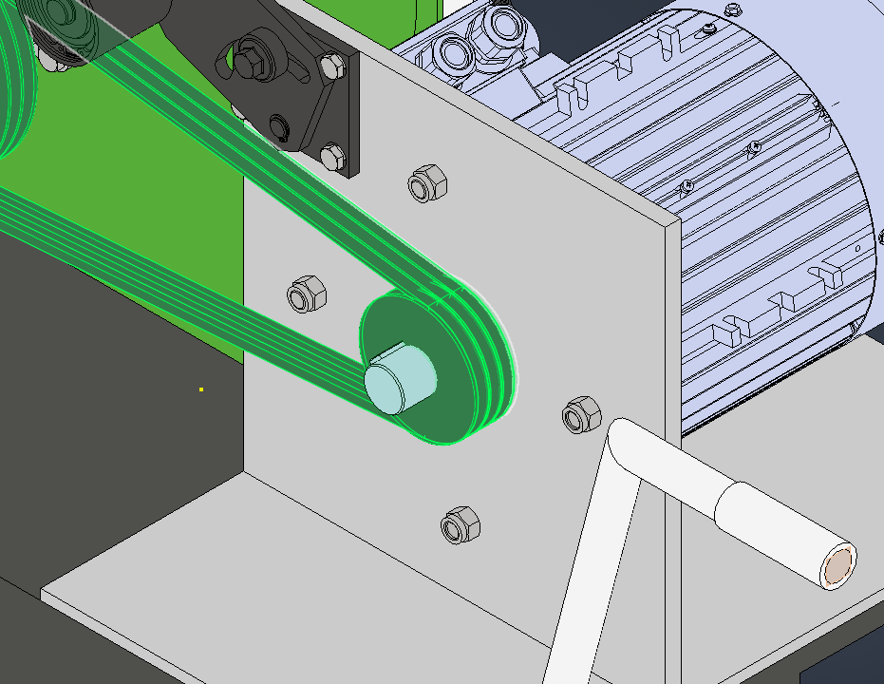
FASTENER SELECTION
NON-STANDARD SOLUTIONS
Fine pitch high-tensile fasteners were required to match component constraints.
Application | ISO Std | Designation
Motor Mount | ISO 8676 | M15 x 1.5 (10.9)
Tensioner | ISO 8676 | M11 x 1.0 (10.9)
Locking | ISO 10512 | Nyloc Nut (10)

Slide 12
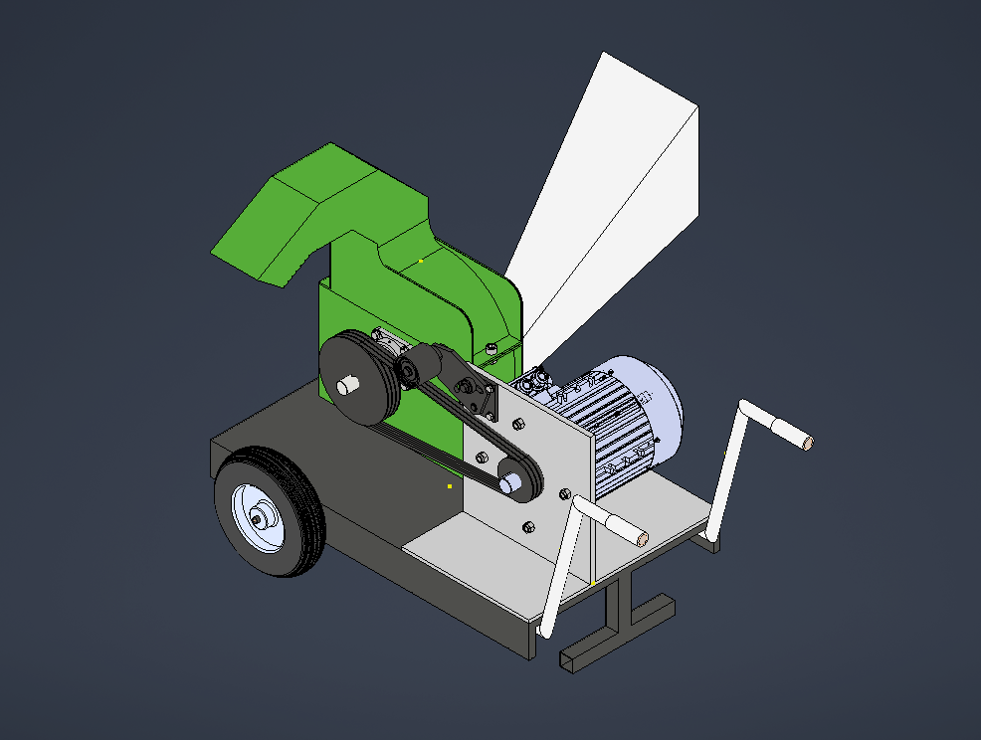
FINAL ASSEMBLY

Slide 13
Thank you for your attention.

